Slide 1
ML.NET In Action
Luis Quintanilla
@ljquintanilla

Slide 2





Hello ☺
Content Developer
Luis.Quintanilla@microsoft.com
http://luisquintanilla.me
@ljquintanilla
https://github.com/lqdev
Notes:
Consultant
Interests: Artificial Intelligence, IoT and all things .NET
GitHub: lqdev
Twitter: @ljquintanilla
Blog: luisquintanilla.me

Slide 3
Code & Slides
http://bit.ly/MLNETInAction

Slide 4
Agenda
01
What is Machine Learning?
02
From Data to Machine Learning
03
Building a Model
04
Deploying a Model
Notes:
What is Machine Learning
From Data to Machine Learning
Building a Model
Deploying a Model

Slide 5
What is Machine Learning?

Slide 6
AI vs ML
Artificial Intelligence
Machine Learning
Notes:
AI
Automating tasks usually performed by humans
Rules-Based Systems/Symbolic Programming
Example: If-Then
Machine Learning
Finding useful data representations within a predefined space
Example: Linear Regression

Slide 7
Machine Learning Tasks
Supervised Learning
Unsupervised Learning
Regression
Classification
Clustering
What is the price of a home in NYC?
Is this a dog or cat?
Customer segments in a database
Notes:
Supervised Learning
Regression – What is the price of a home in NYC?
Classification – Is this a dog or a cat?
Unsupervised Learning
Clustering – What kinds of topics are present in this database

Slide 8
Classification Example
Training Data
New Data
Species | Is Independent | Class
Canine | False | Dog
Feline | True | Cat
Feline | True | Cat
Canine | False | Dog
Canine | True | Dog
Species | Is Independent
Canine | False
Prediction
Features
(input)
Label
(output)
Class
Dog

Slide 9
From Data to Machine Learning

Slide 10

The Continuous Machine Learning Process

Slide 11

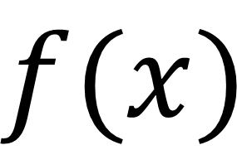
What is a model?
True
$$f(x)$$
False
Input
Model
Output

Slide 12
Building a Machine Learning Model

Slide 13









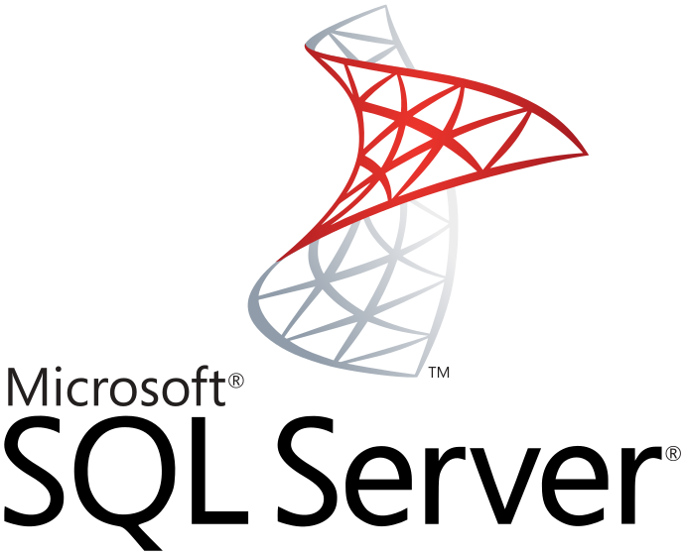





Automated vs. Custom
Automated
Custom

Slide 14

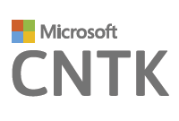


.NET Tools

Slide 15




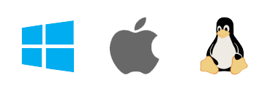
ML.NET
Framework for Machine Learning
Proven & Extensible
.NET Standard
Open Source
Cross Platform
Notes:
Framework for custom Machine Learning
.NET Standard
Proven & Extensible
Open Source
Cross Platform

Slide 16
ML.NET - Framework
Transforms
Missing Values
Feature Selection
Learners
SVM
K-Means
Misc
Data Loaders
Evaluators
Extensions
Normalization
Boosted Trees
TensorFlow
CNTK
ONNX
Accord.NET
Notes:
Build and train ML.NET Models
Run ANY Model

Slide 17
A few things you can do with ML.NET …
Sentiment Analysis
Forecasting
Issue Classification
Predictive maintenance
Image classification
Recommendations
Spam detection
Customer segmentation
And more! Samples @ https://github.com/dotnet/machinelearning-samples

Slide 18
ML.NET Concepts
MLContext
IDataView
Tabular representation of data
ITransformer
Transforms IDataViews
IEstimator
Performs data operations
PredictionEngine
Takes in data features and outputs predictions

Slide 19
ML.NET Concepts (Cont’d)
IEstimator
IDataView
IDataView

Slide 20
ML.NET Pipelines
Pipeline
Data Preparation
Training

Slide 21
Demo: Train Classification Model

Slide 22
Consuming a Machine Learning Model

Slide 23



Deploying to the Web
Virtual Machines
Containers
Serverless
Notes:
https://dzone.com/articles/virtual-machines-vs-containers-vs-serverless-compu

Slide 24
Demo: Deploying Model to the Web

Slide 25
Demo: Pre-trained TensorFlow Model Scoring
Notes:
https://github.com/dotnet/machinelearning-samples/tree/master/samples/csharp/getting-started/DeepLearning_ImageClassification_TensorFlow

Slide 26
Takeaways
ML.NET is a proven, open-source, cross-platform machine learning framework for building custom models in the .NET ecosystem.
ML.NET is still in its early stages but is quickly maturing with strong support from open source community and Microsoft.
Model persistence provides great flexibility in model deployment phase.
Azure (Container Instances and Functions) reduces friction and management overhead associated with deployment of ML.NET models to the web.
Take your existing models and use in .NET

Slide 27
We ❤️ Feedback
https://www.research.net/r/QP6R39Y

Slide 28
Questions?

Slide 29
Resources
https://docs.microsoft.com/en-us/dotnet/machine-learning/resources/glossary
https://docs.microsoft.com/en-us/dotnet/machine-learning/tutorials/
https://docs.microsoft.com/en-us/dotnet/machine-learning/how-to-guides/
https://github.com/dotnet/machinelearning-samples
http://luisquintanilla.me/2018/08/21/serverless-machine-learning-mlnet-azure-functions/
http://luisquintanilla.me/2018/05/11/deploy-netml-docker-aci/

